Slide 1
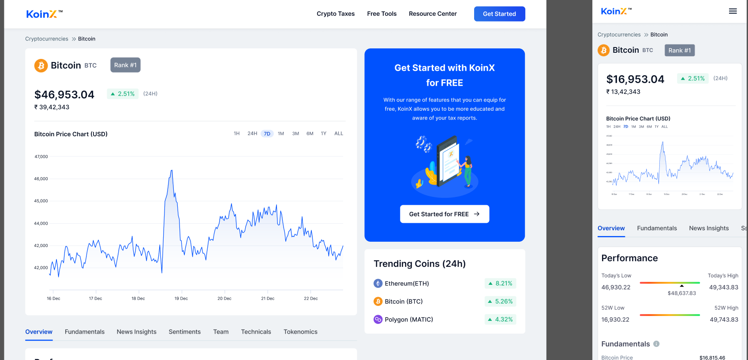

Slide 2
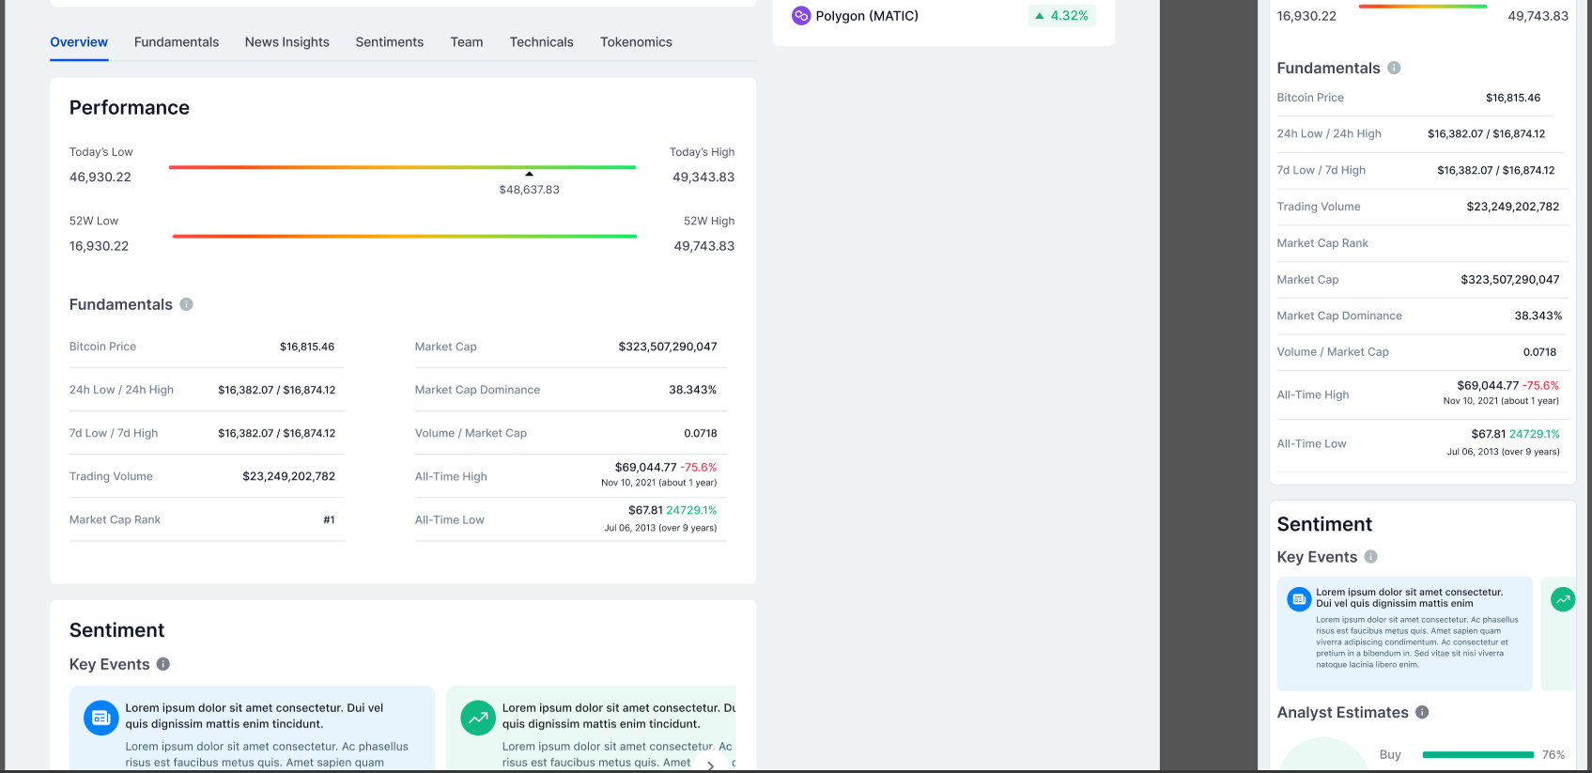

Slide 3
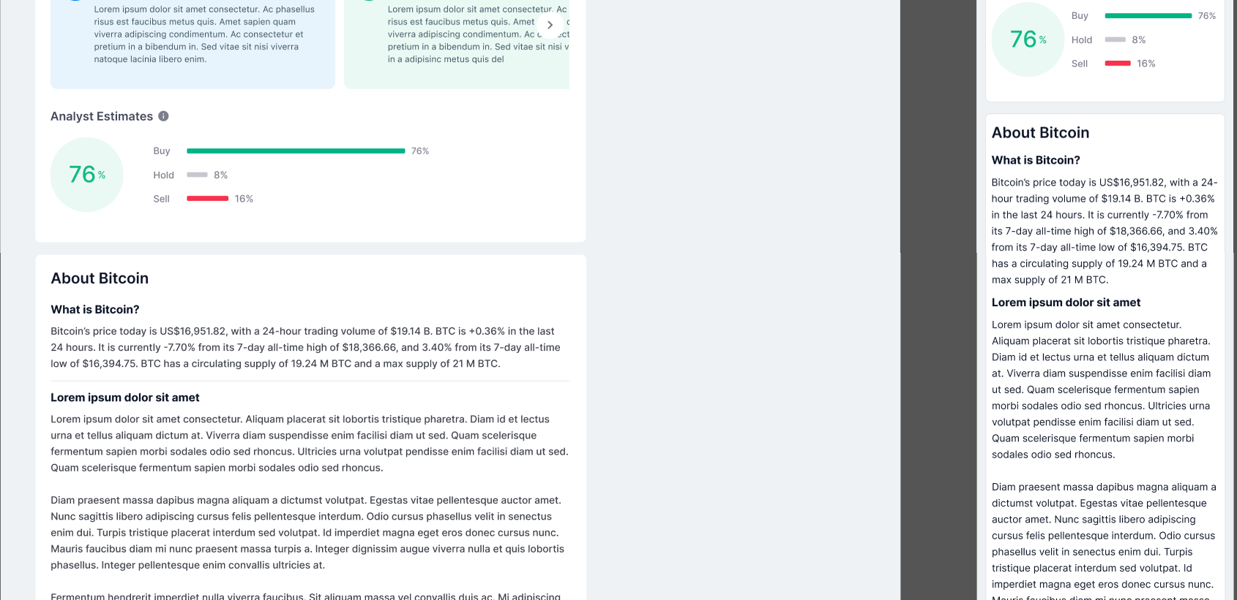

Slide 4
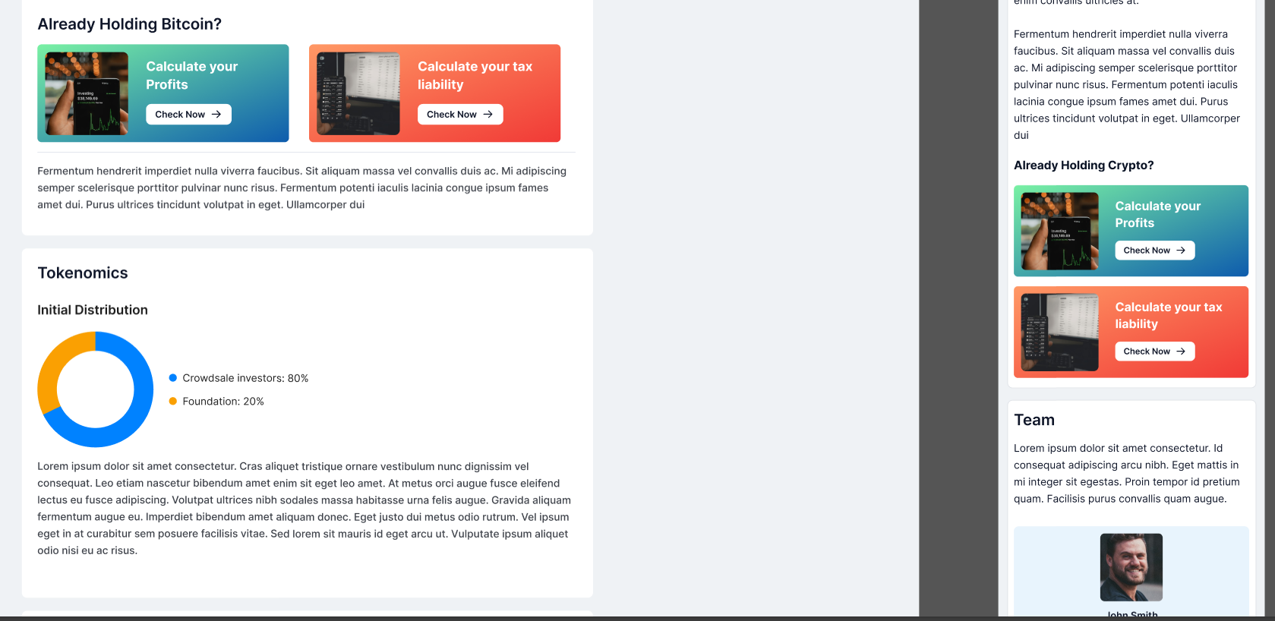

Slide 5
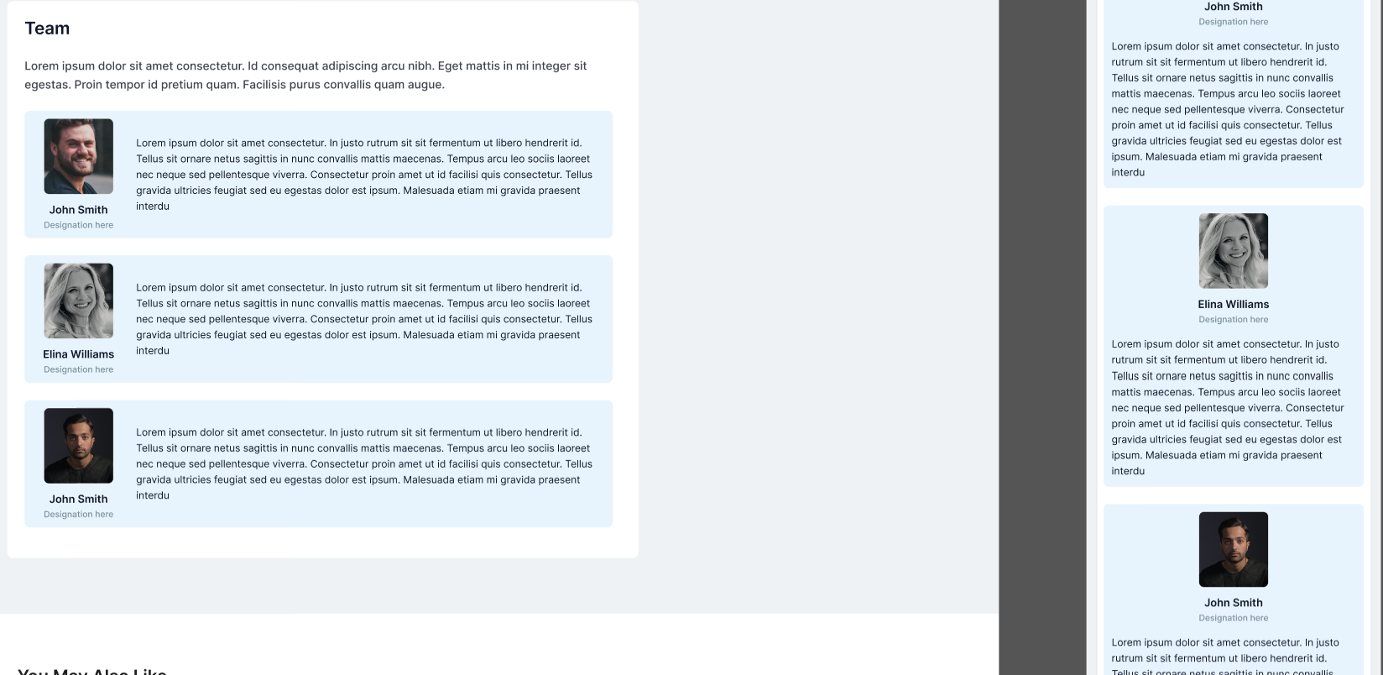

Slide 6
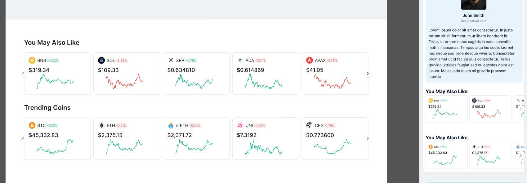

Slide 7


Slide 8
Mandatory Tasks:
Implement all the components as given in the Figma design.
Use Coingecko’s /simple/price API to fetch the price of bitcoin in USD and INR.
Coingecko API Documentation: https://www.coingecko.com/api/documentation
API Parameters:
ids: bitcoin
vs_currencies: inr,usd
include_24hr_change: true
You can get the symbol of the coin using the /coins/{id} API from Coingecko in order to render the relevant price chart from TradingView.
This will give you the price of Bitcoin in USD, INR and 24H change. You can use USD’s 24H change to display the change value.
Sample API Response
{
"bitcoin": {
"inr": 5697177,
"inr_24h_change": 3.6596920153414336,
"usd": 68726,
"usd_24h_change": 3.6767559459431545
}
}
--------------------------------------

Slide 9
You can embed TradingView’s charts of BTCUSD in place of the chart component in the Figma design: https://www.tradingview.com/widget-docs/widgets/charts/advanced-chart/. You don’t have to implement the chart component from scratch, just use the TradingView widget. Try modifying the widget values to bring the widget design as close as the one in the Figma design.
Use Coingecko’s /search/trending API to fetch the list of top 3 trending coins to be displayed in the “Trending Coins (24h)” component on the right. (Sample API Response)
For the “You May Also Like” section, show the logo, symbol, price, price change and price graph of the “Trending Coins” that we fetched from the previous API.
Hint: For the graph, there is a sparkline property in the “Trending Coins” API response which gives the graph image for each coin.
The row should be a horizontally scrollable carousel.

